Slide 1
Examples of Ideating with Croquis

Slide 2
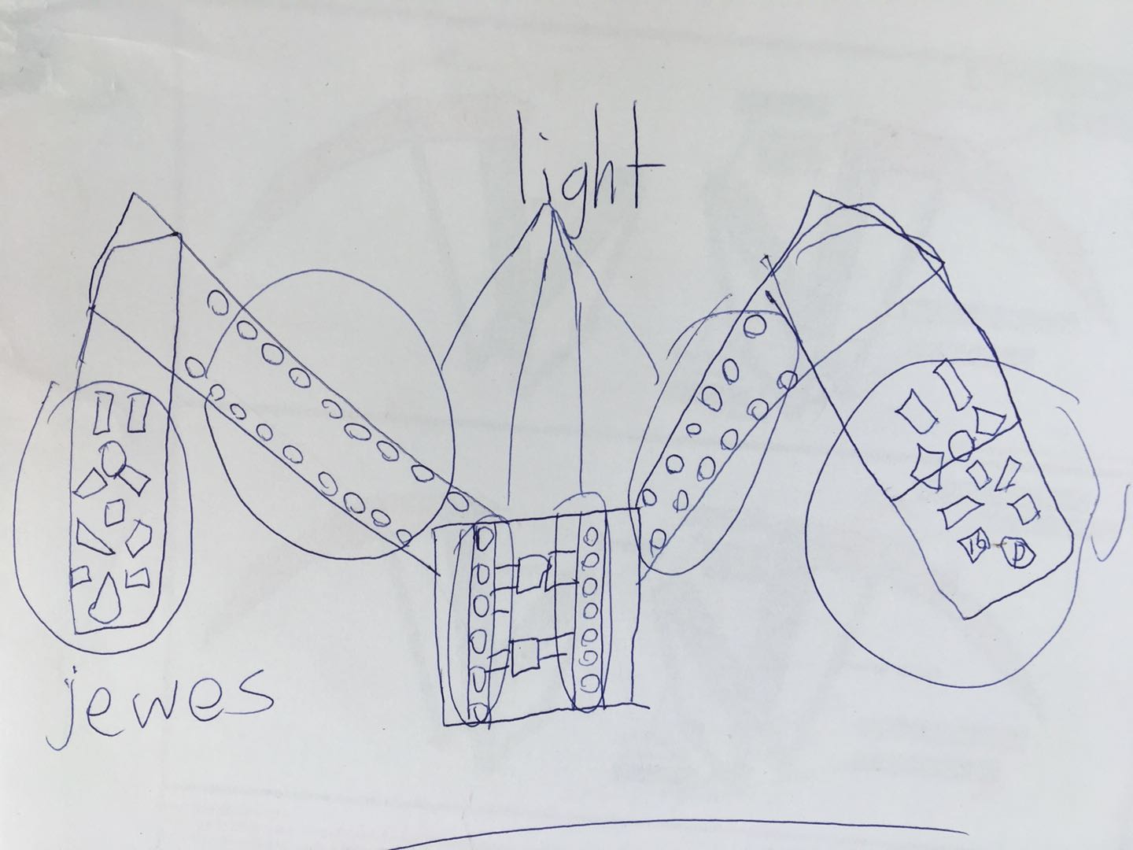
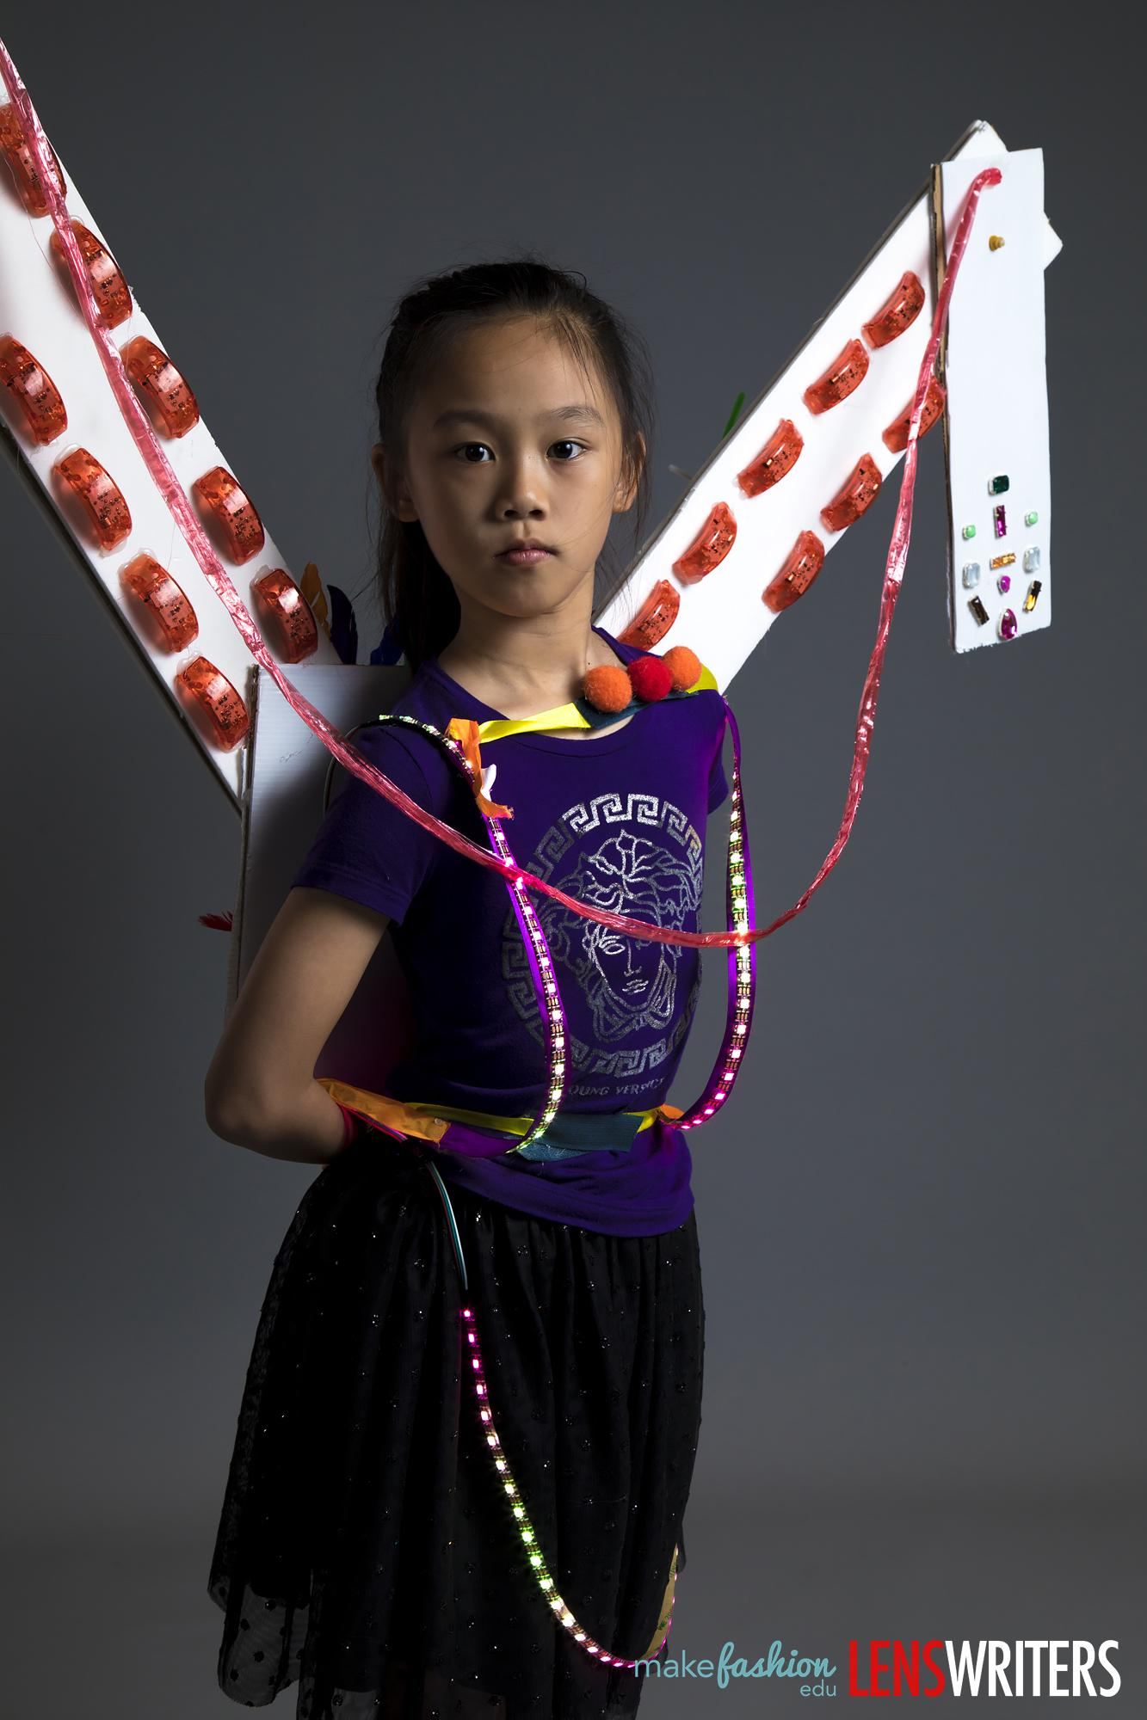
Wings, 3rd Grade
1st Iteration – visual concept

Slide 3
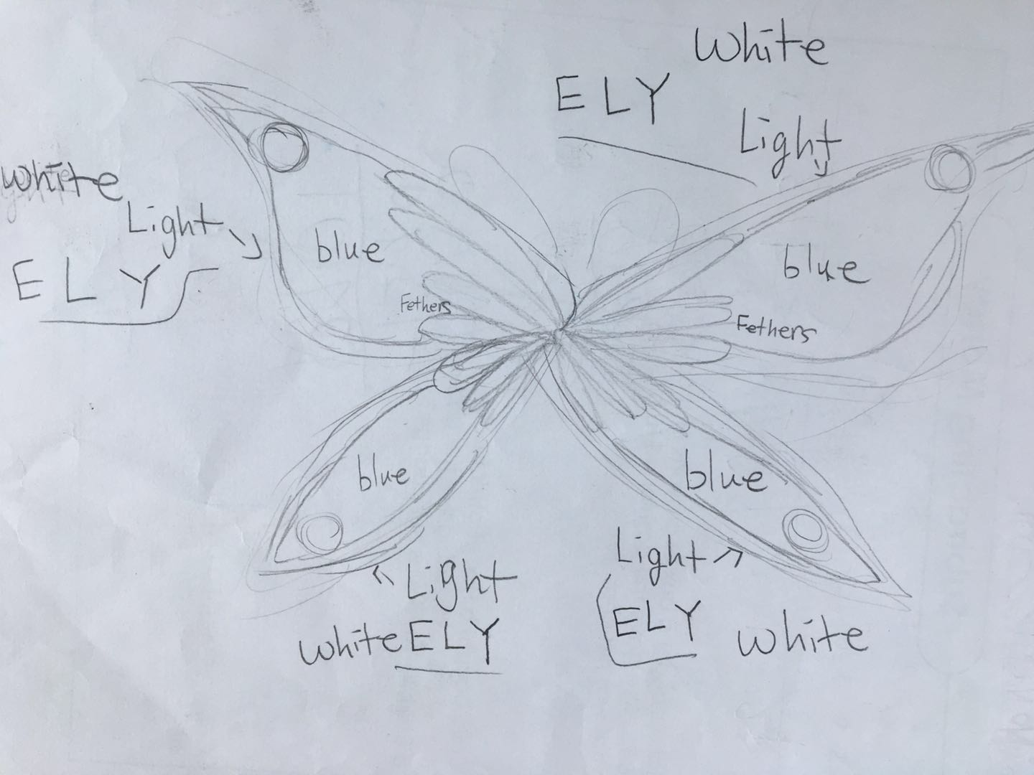
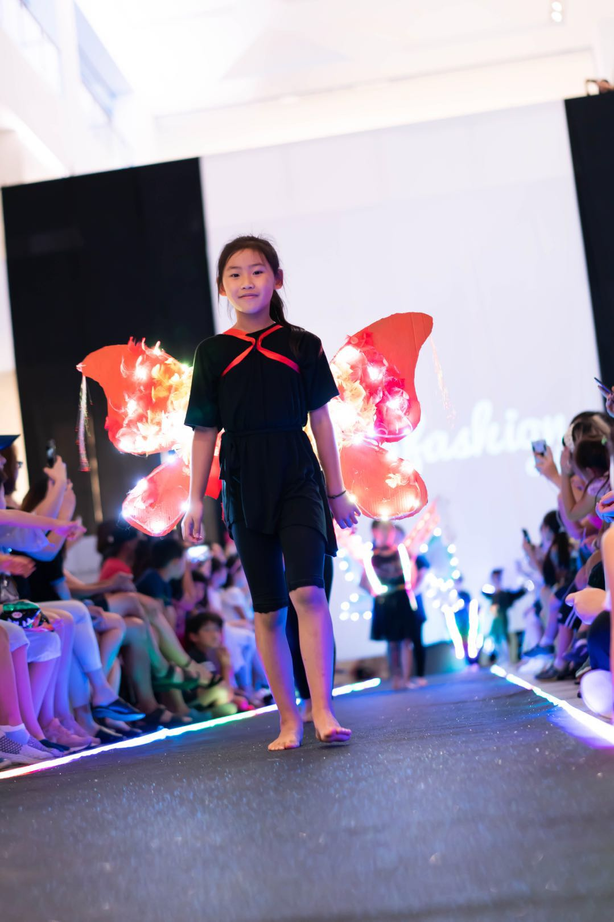
Wings, 3rd Grade
2nd Iteration with light placement + color scheme

Slide 4
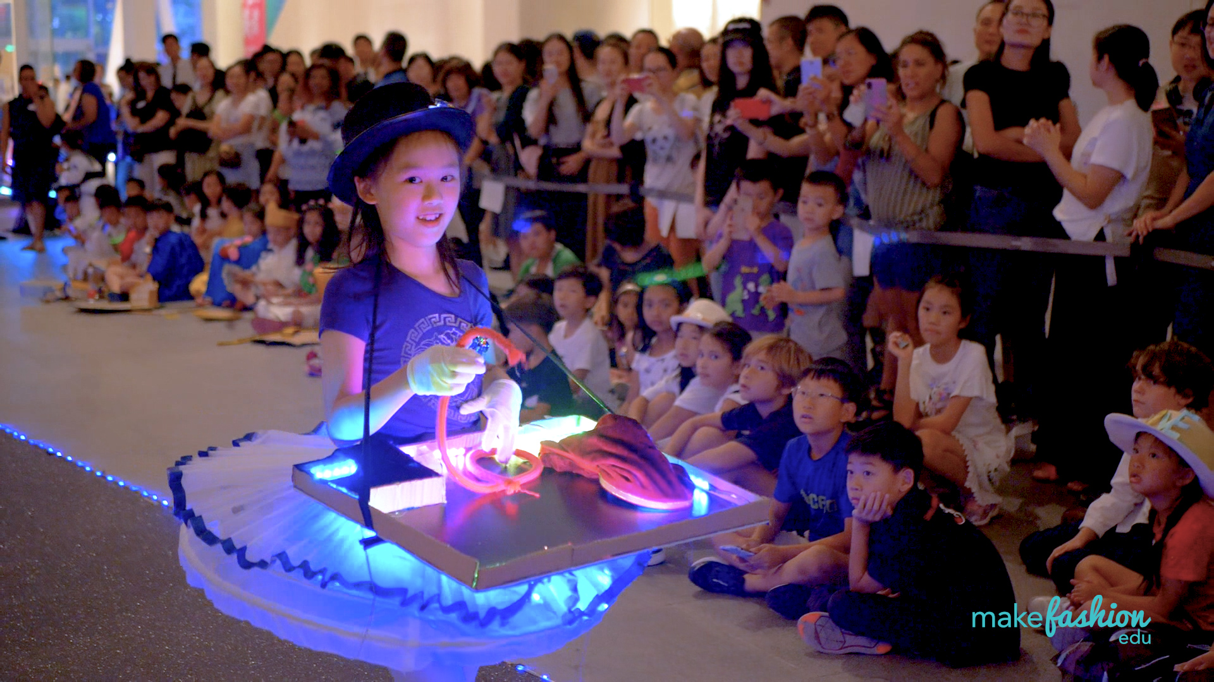
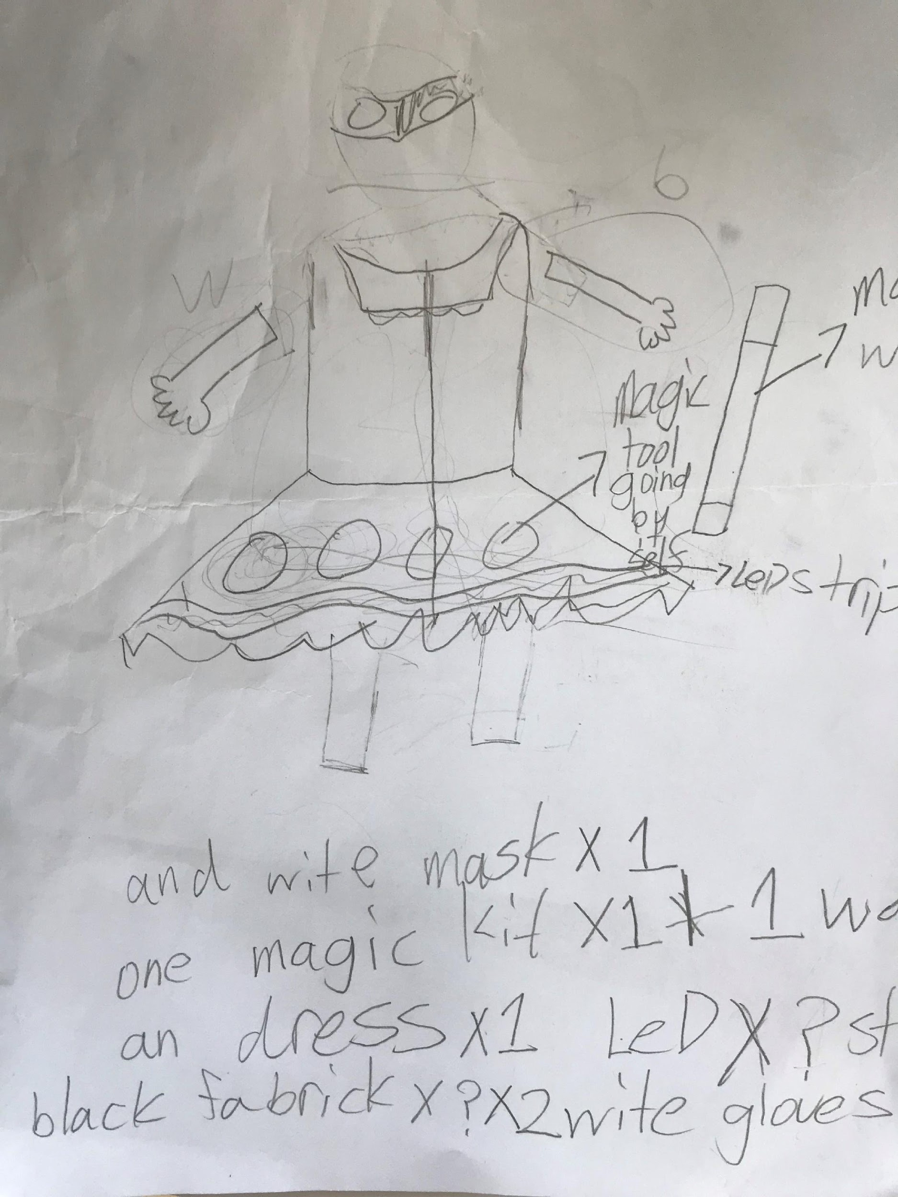
The Magician, 4th Grade
2nd Iteration with draft materials list

Slide 5
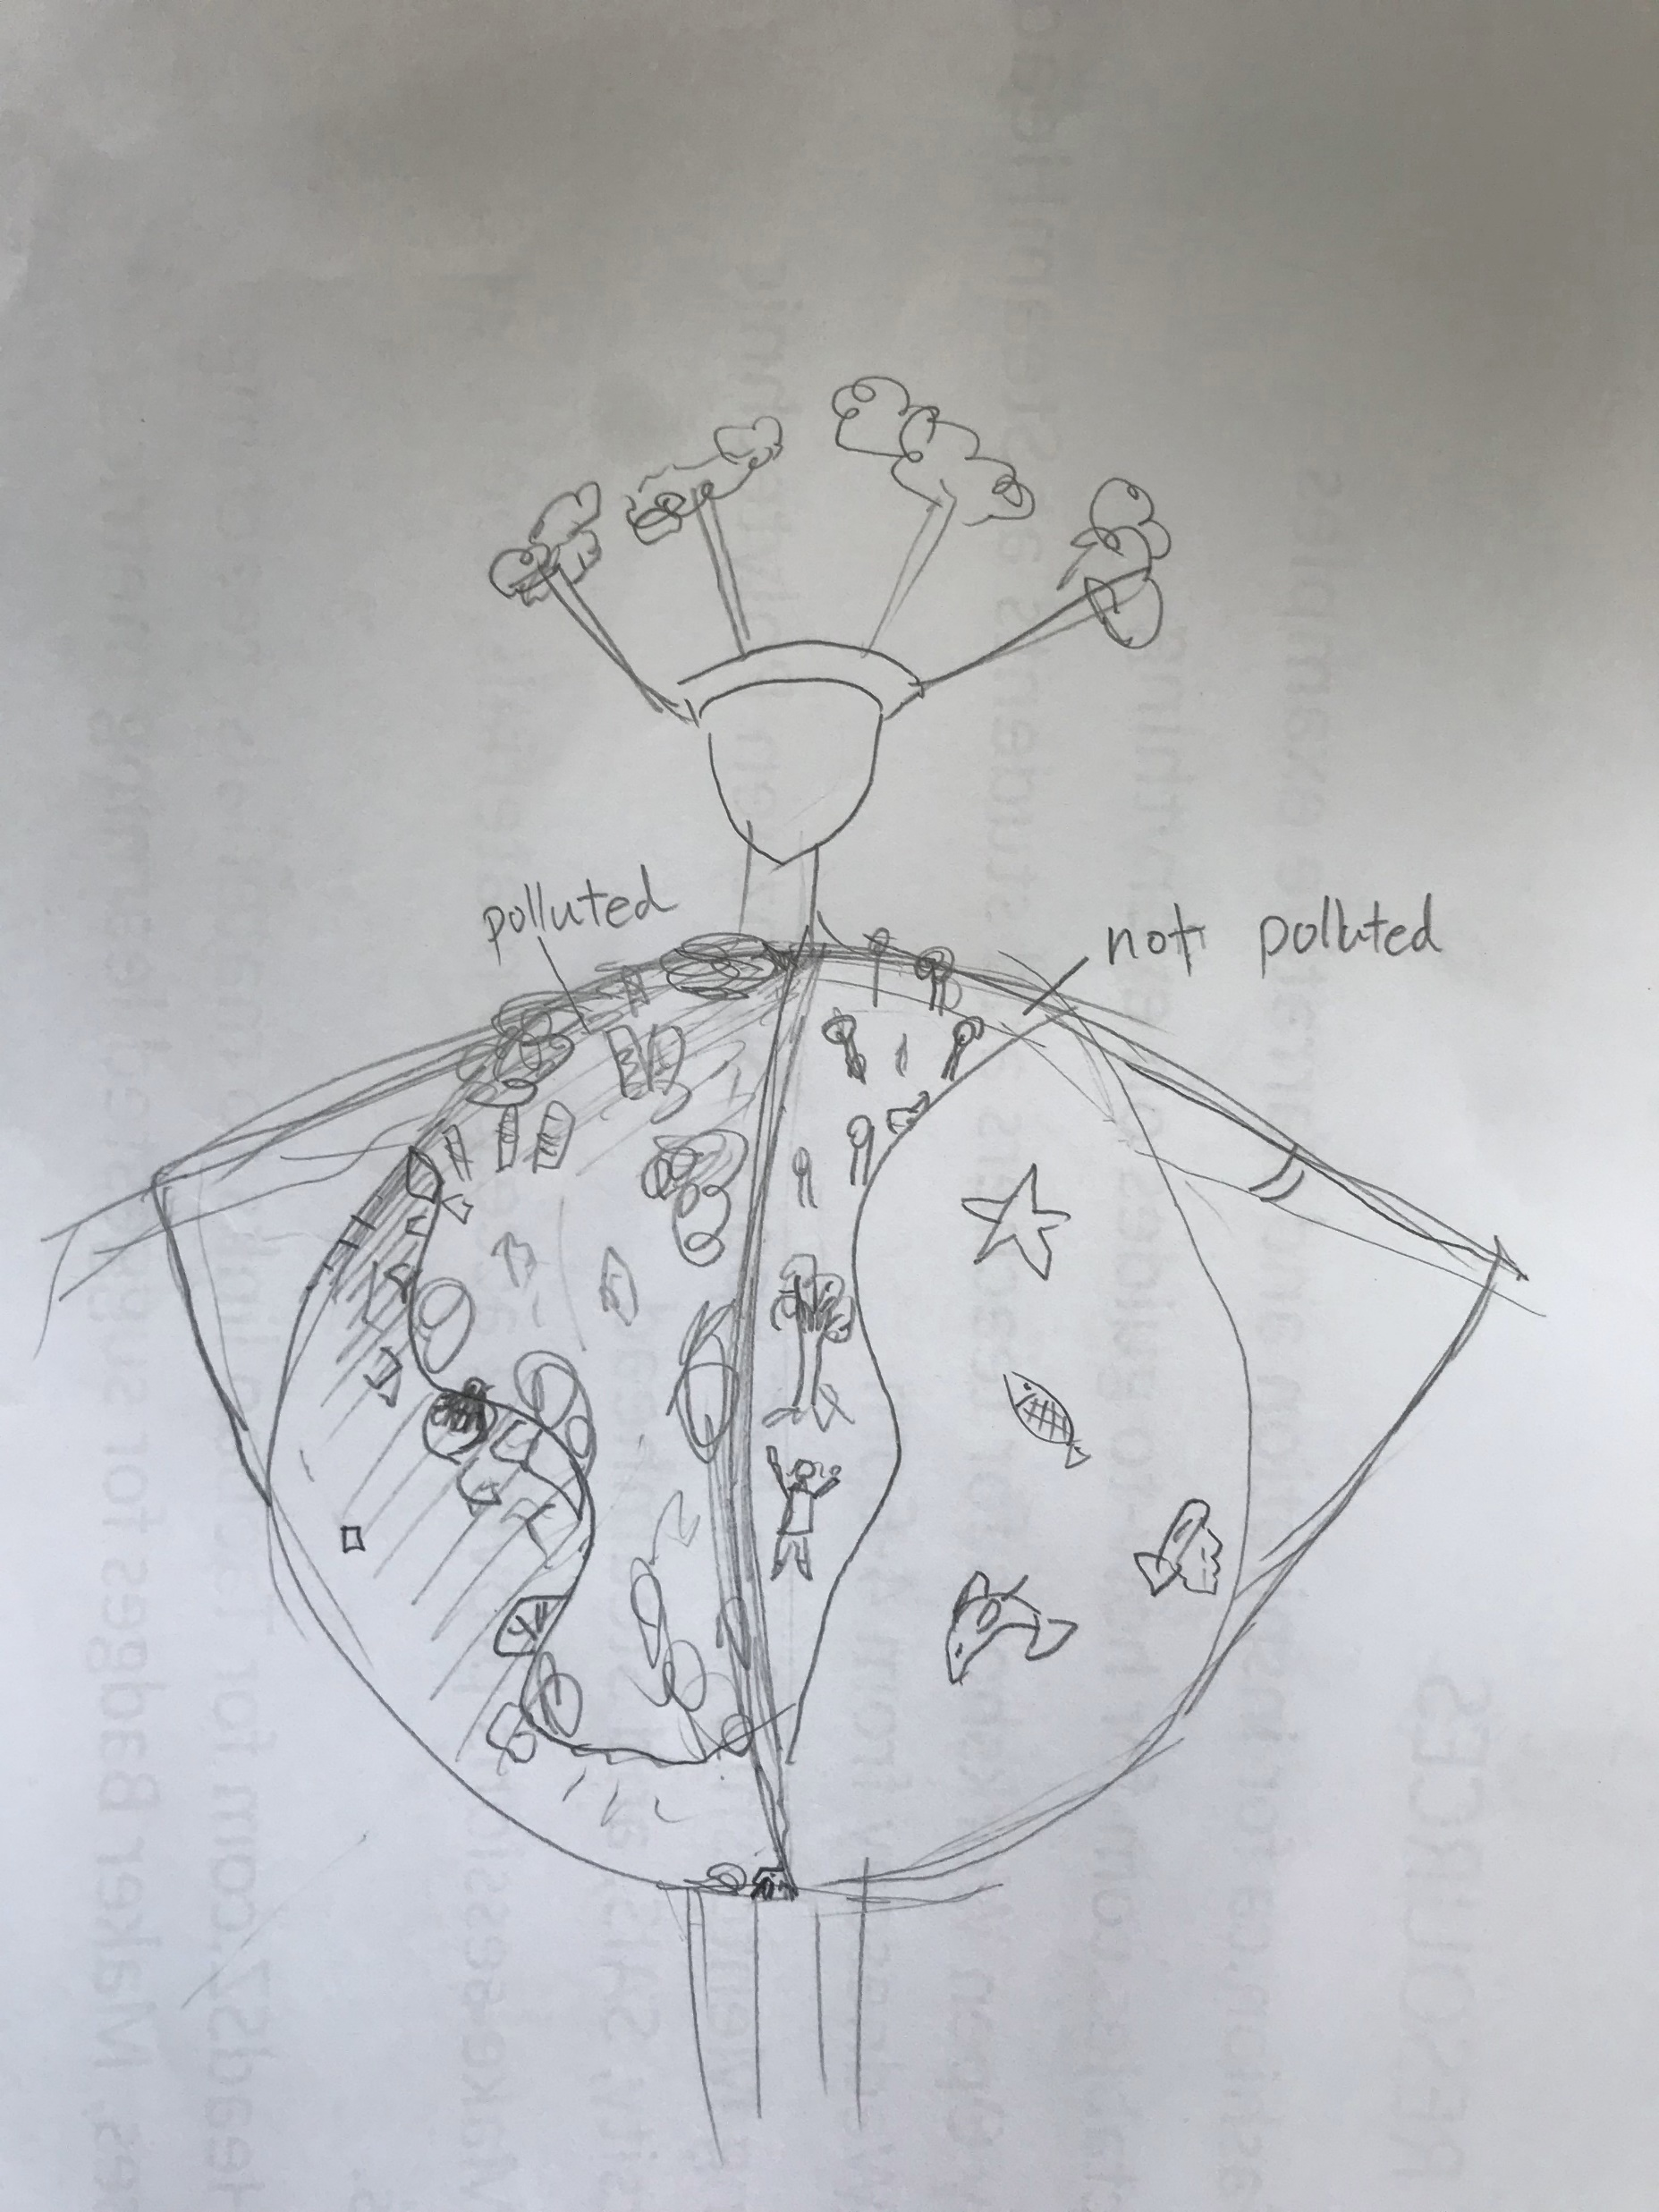
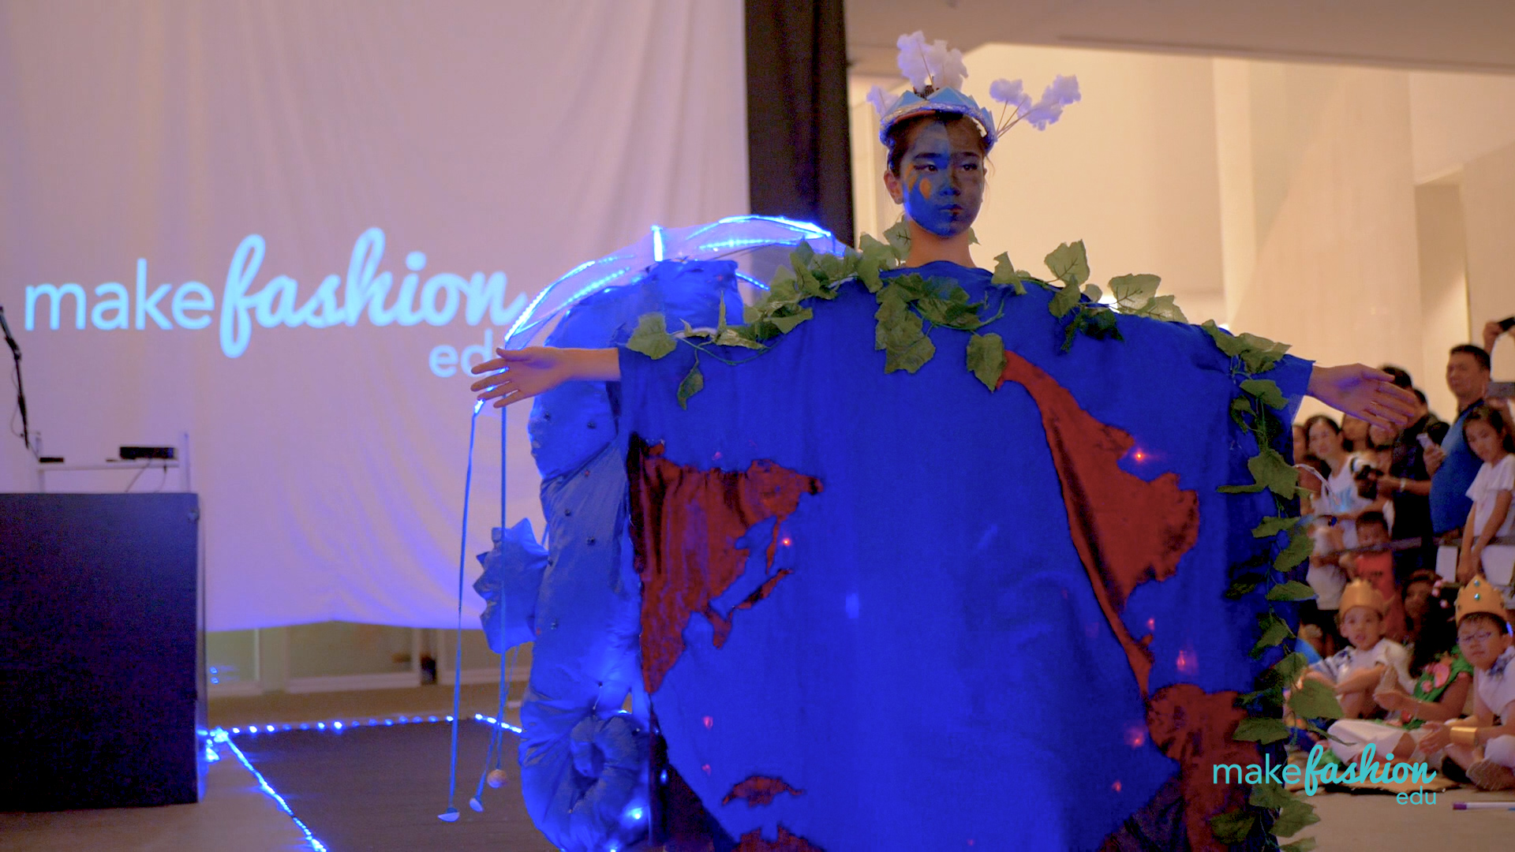
Mother Earth, 5th Grade
1st Iteration - concept

Slide 6
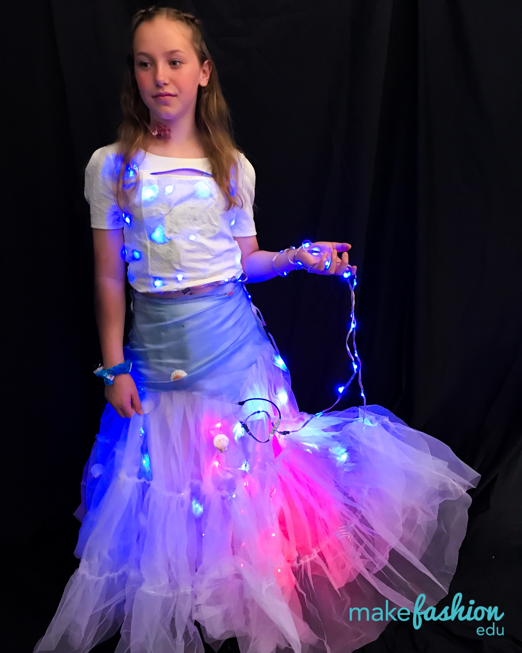
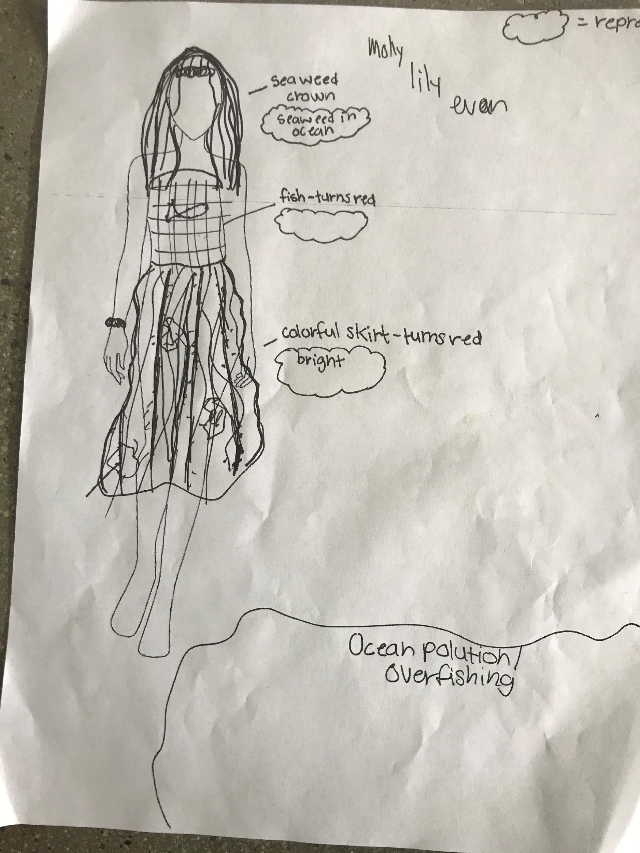
Against Ocean Pollution, 6th Grade
1st Iteration – visualizing the story
Iteration

Slide 7
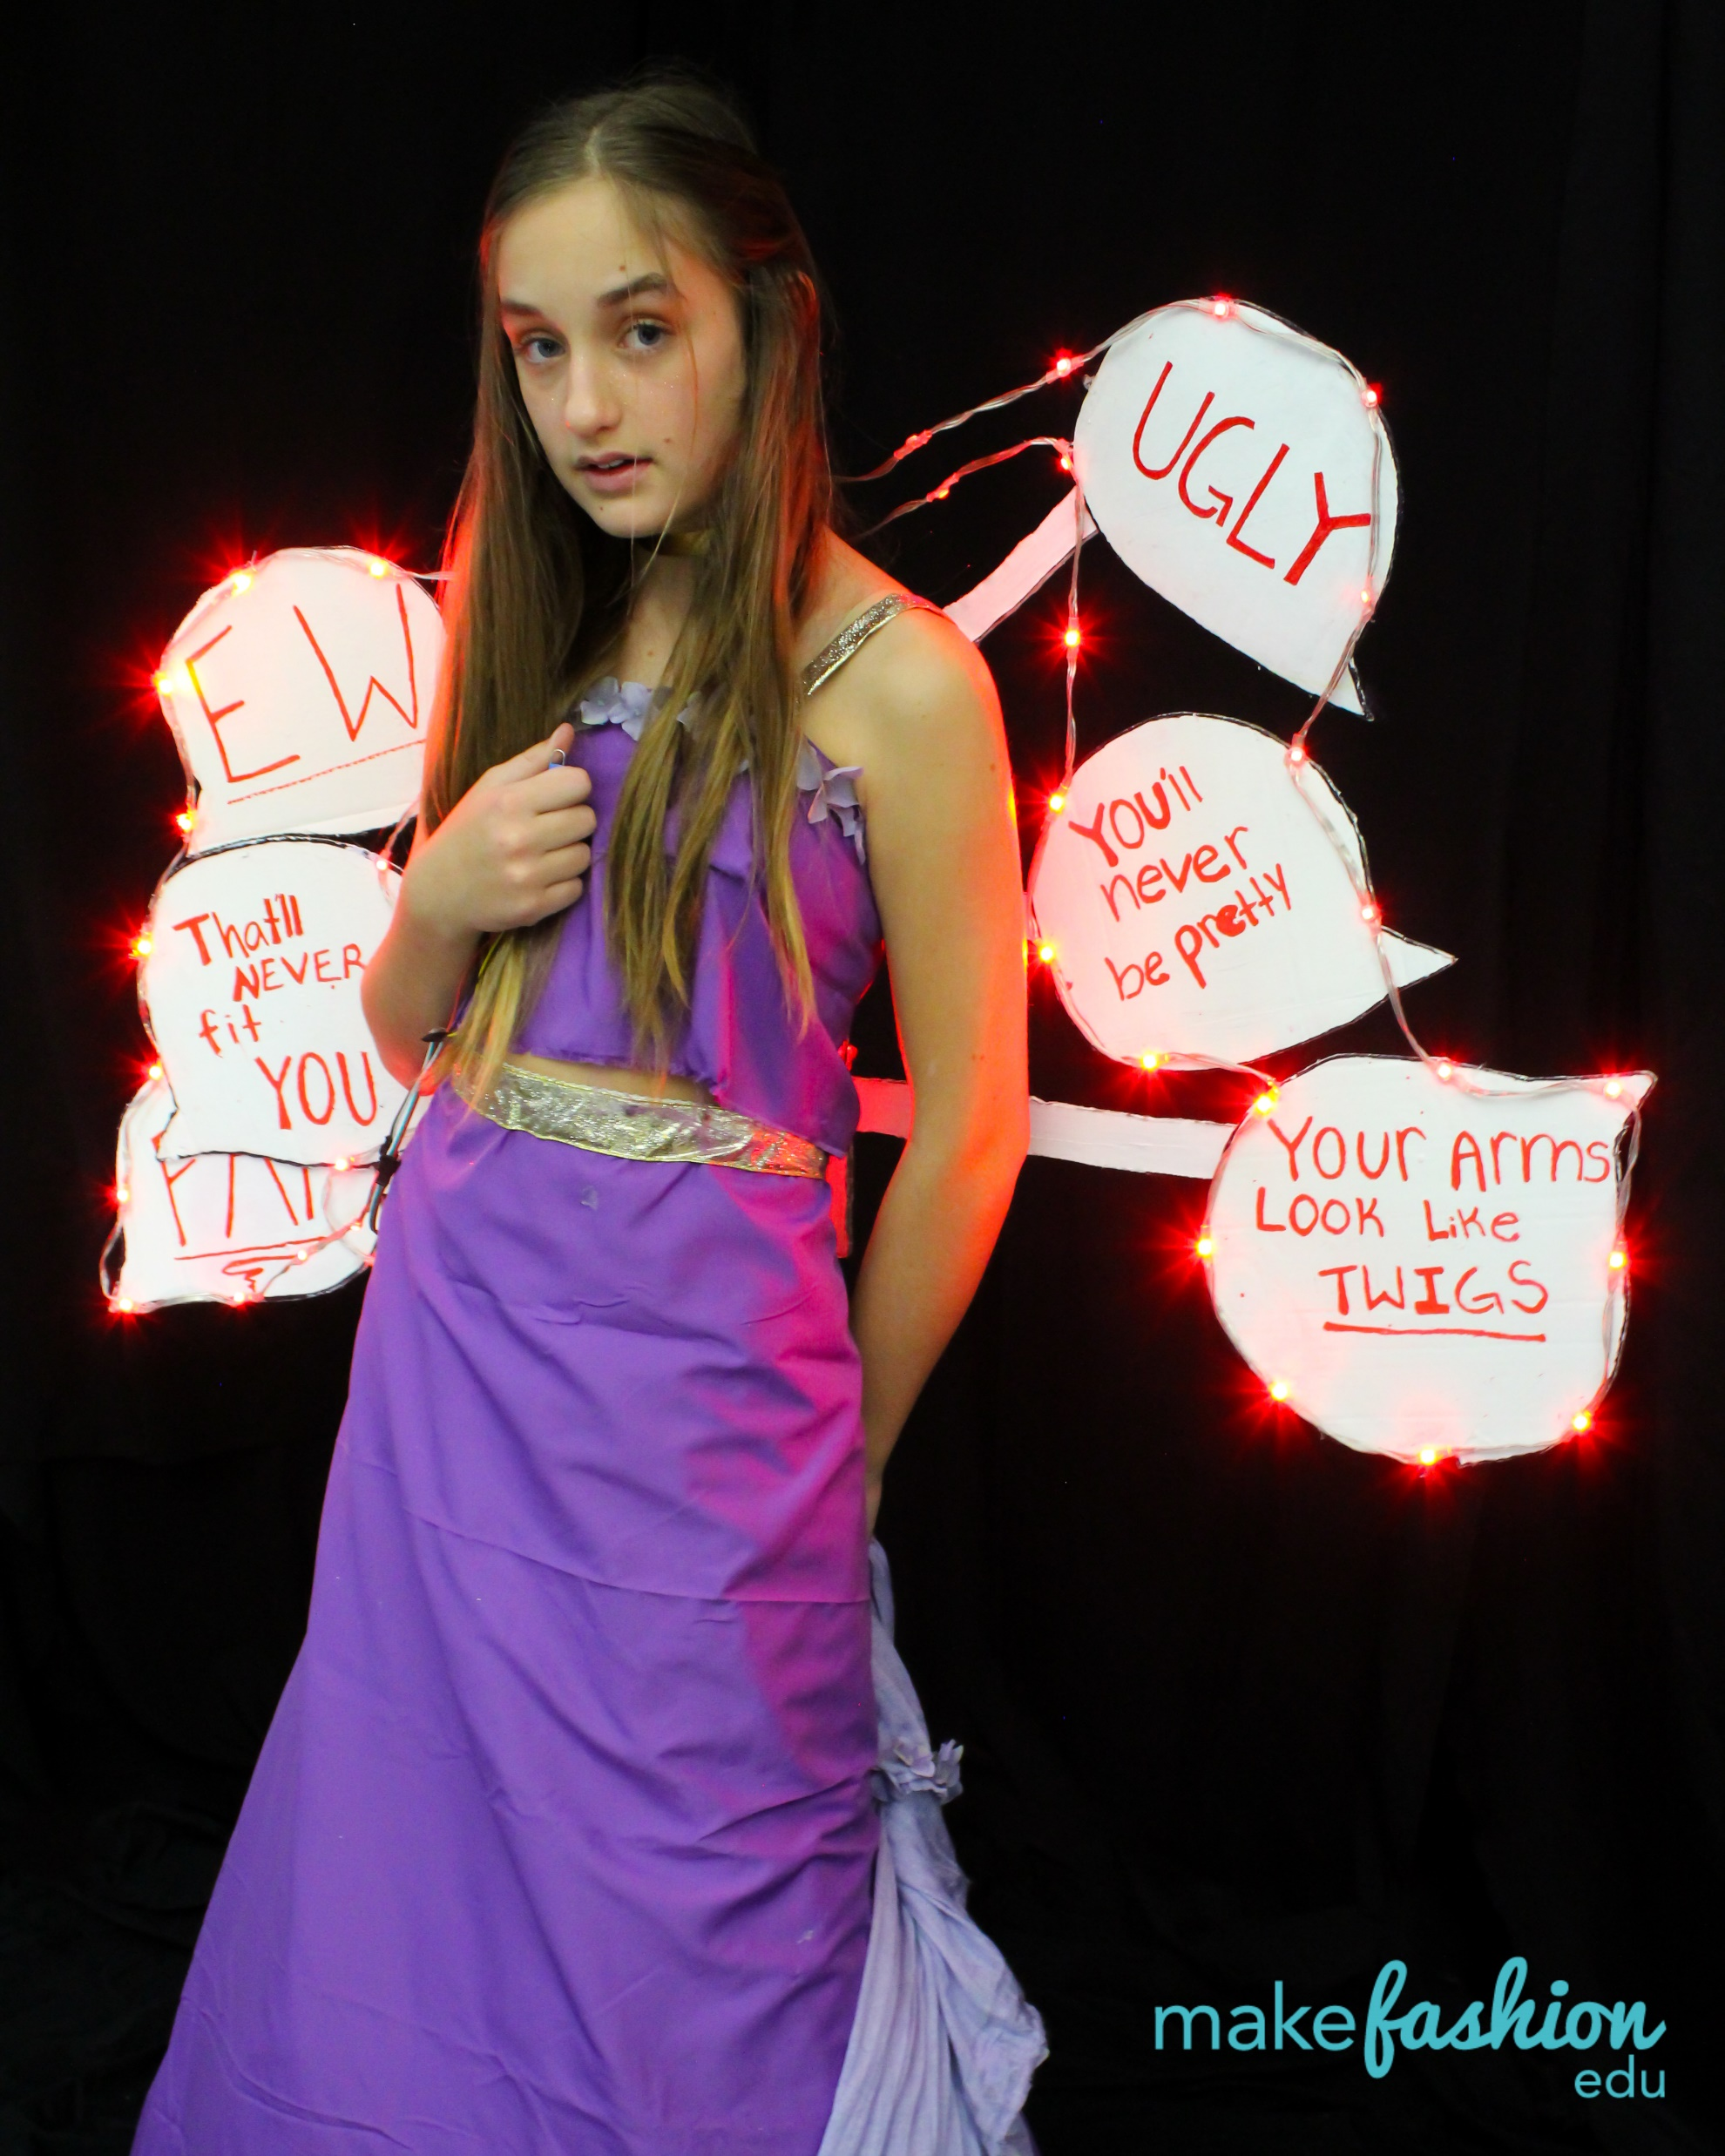
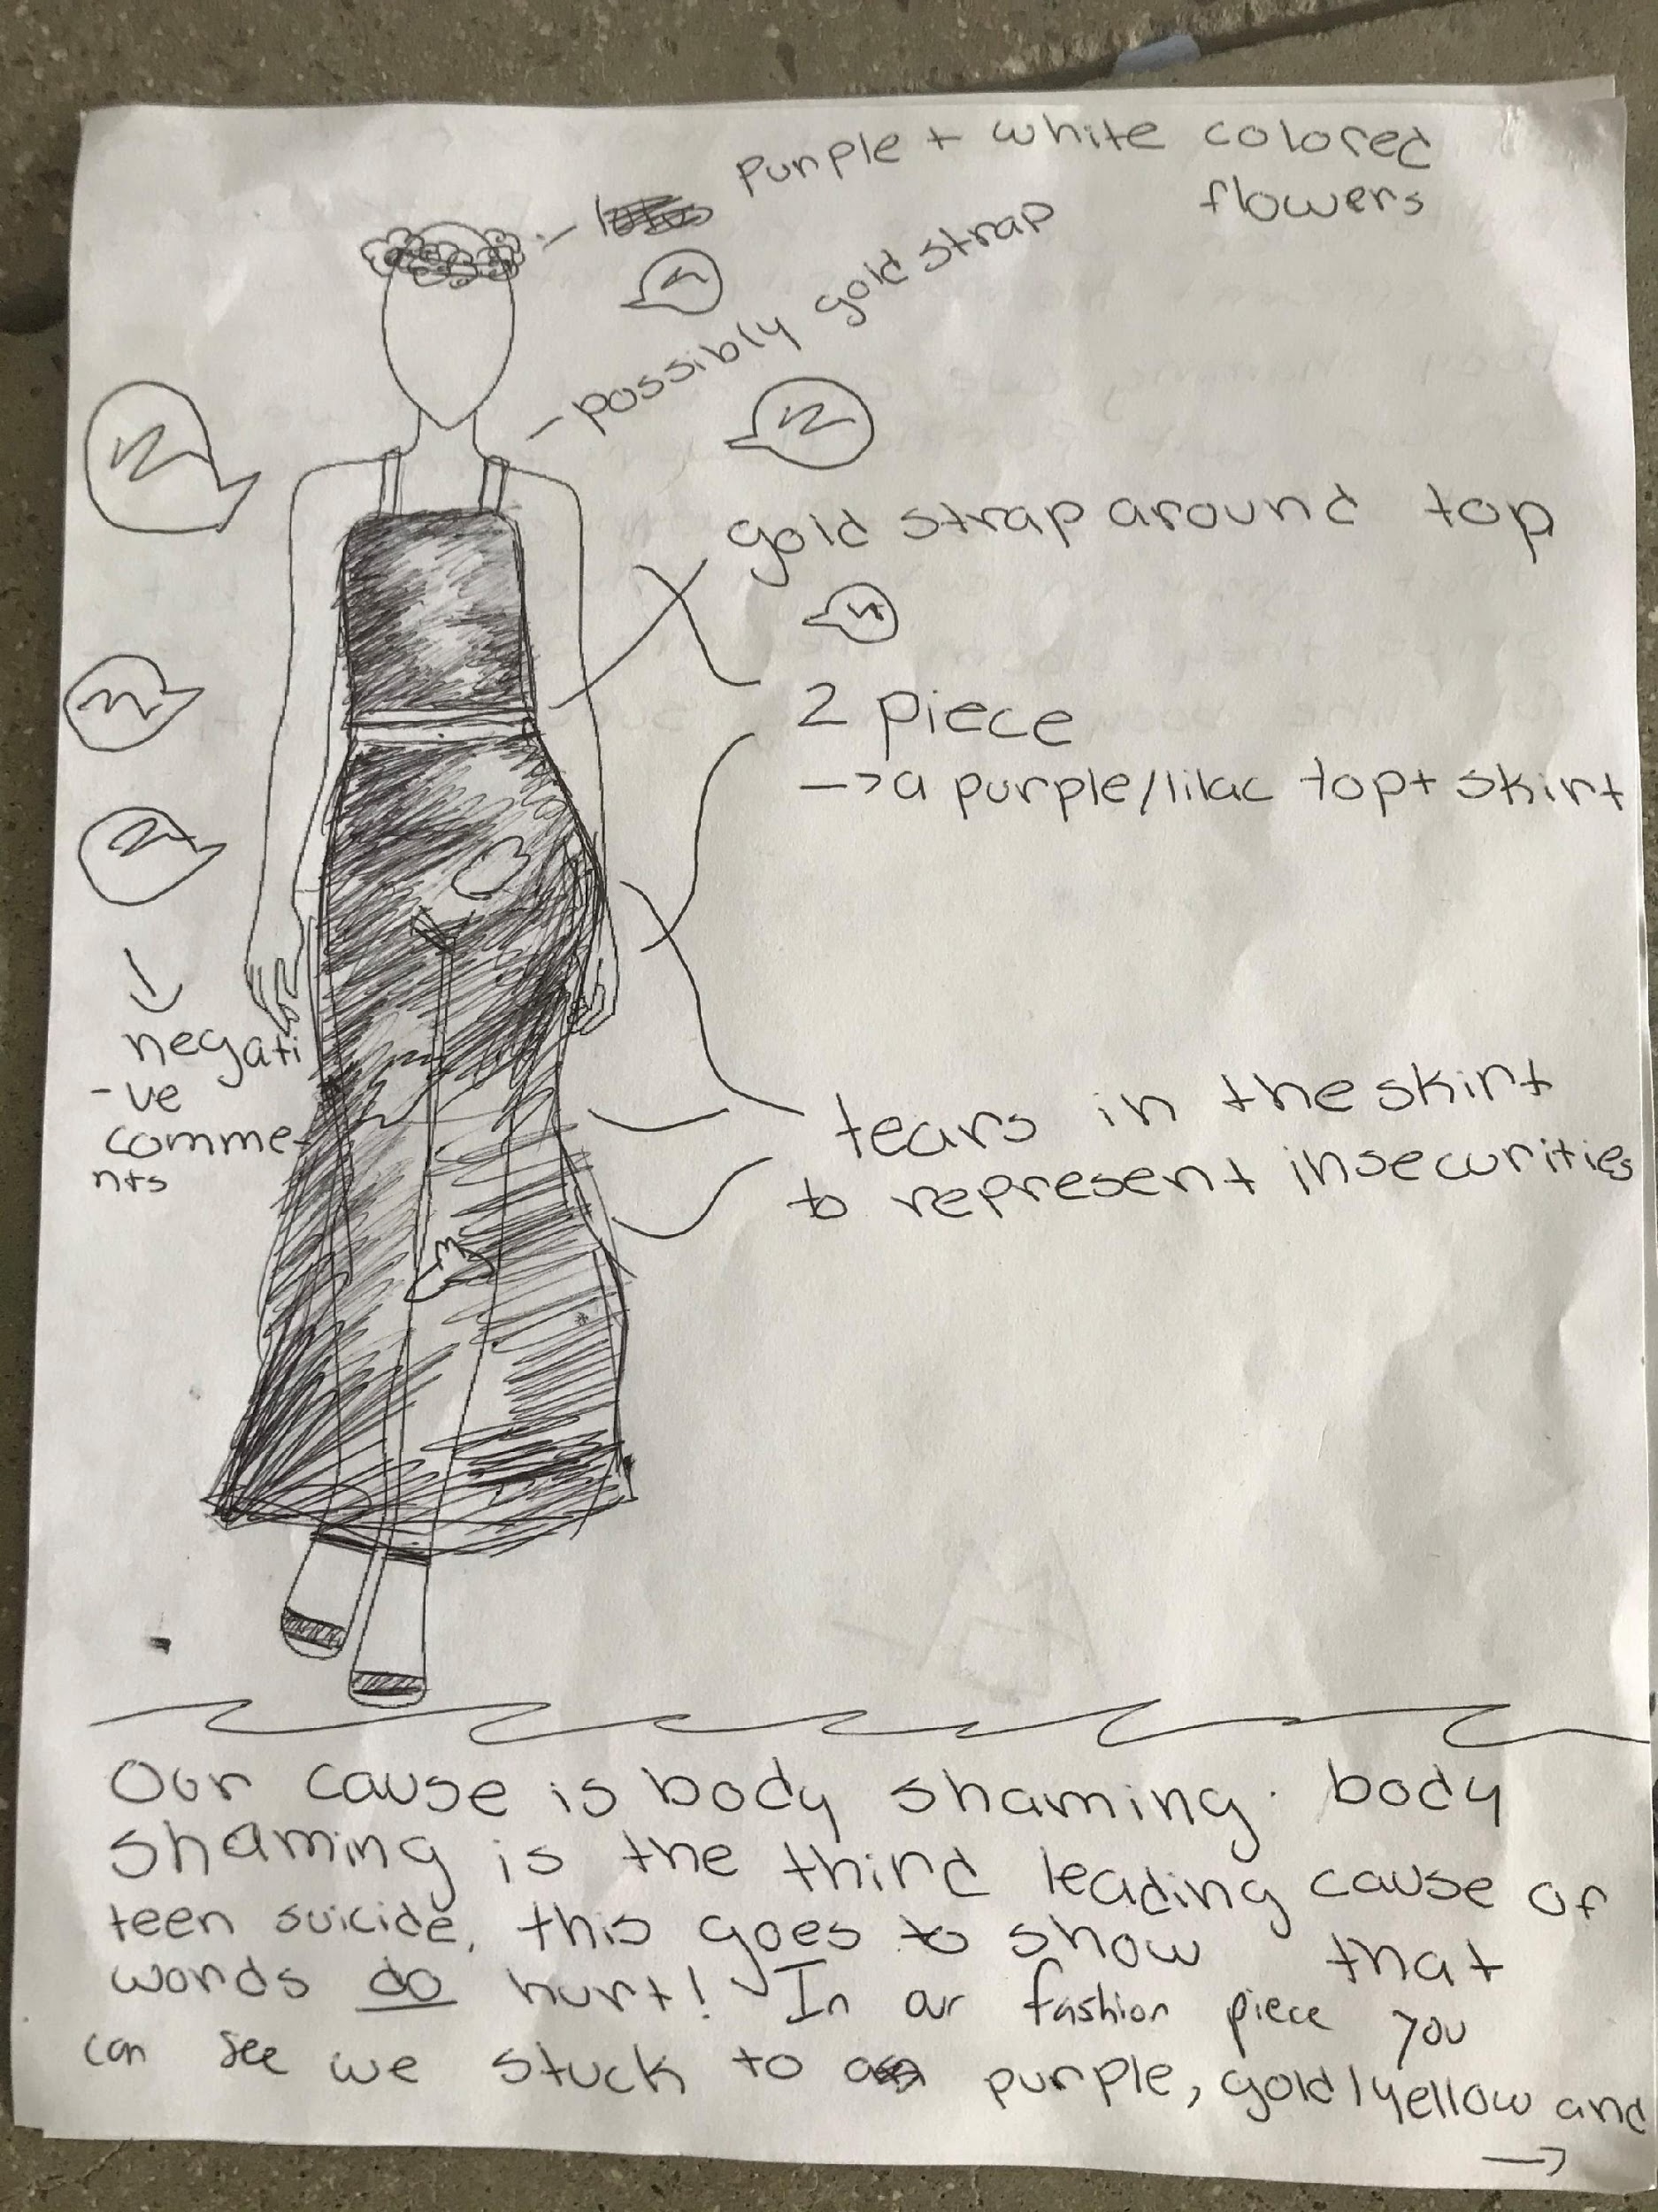
Against Body Shaming, 6th Grade
2nd Iteration – tying symbolism in

Slide 8
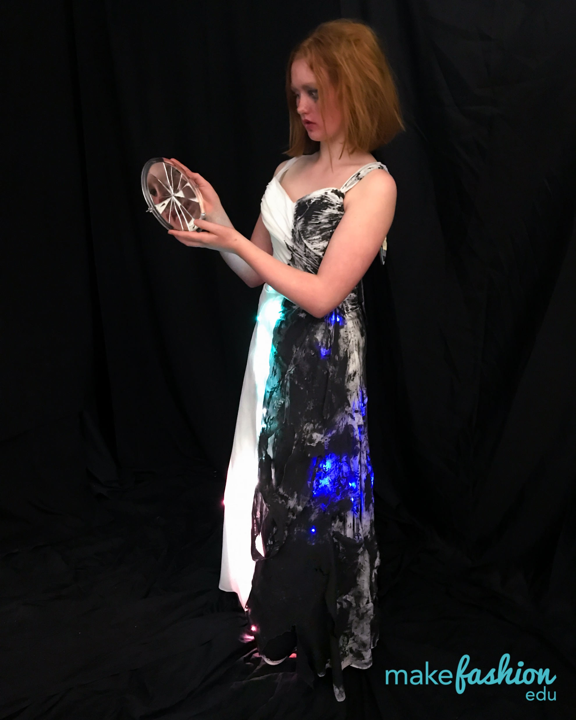
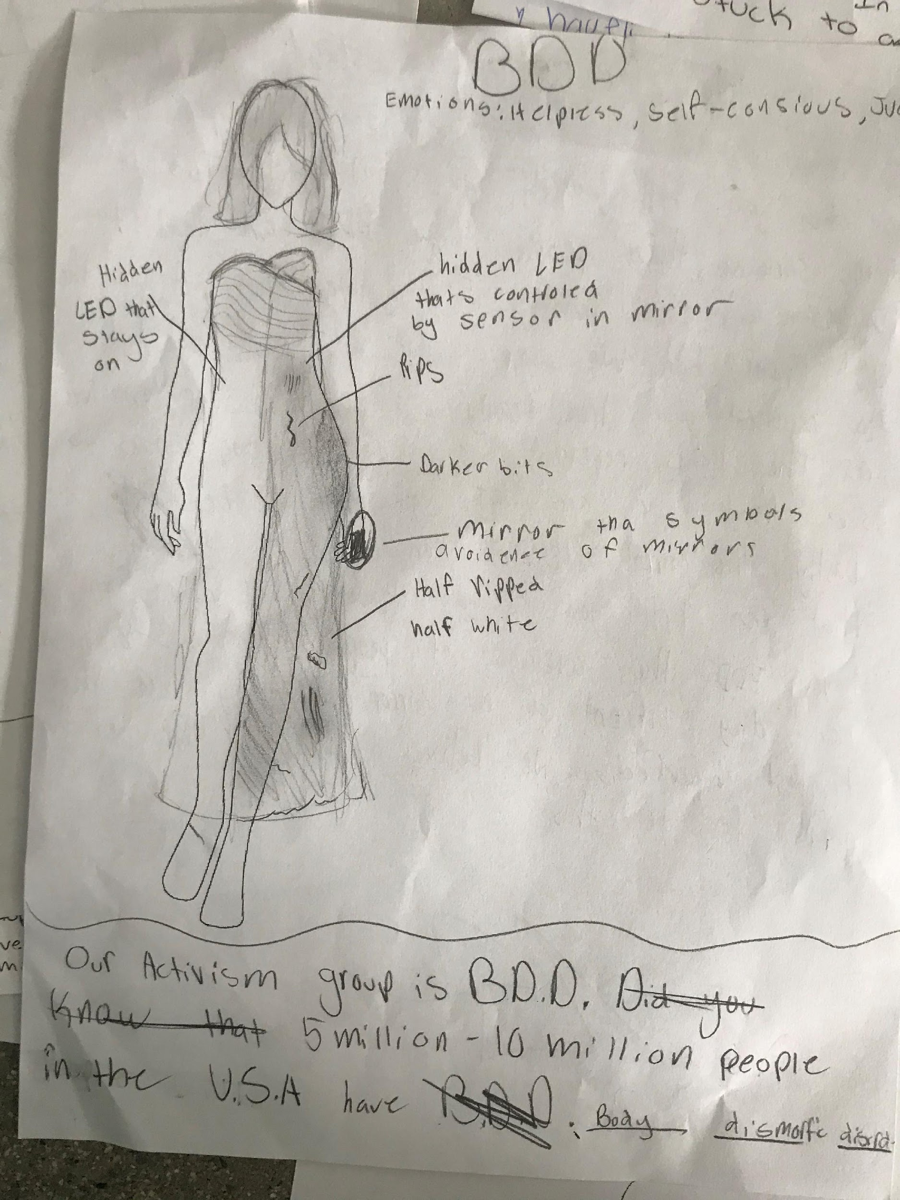
BDD Awareness, 6th Grade
3rd Iteration – elevating symbolism with the electronics

Slide 9
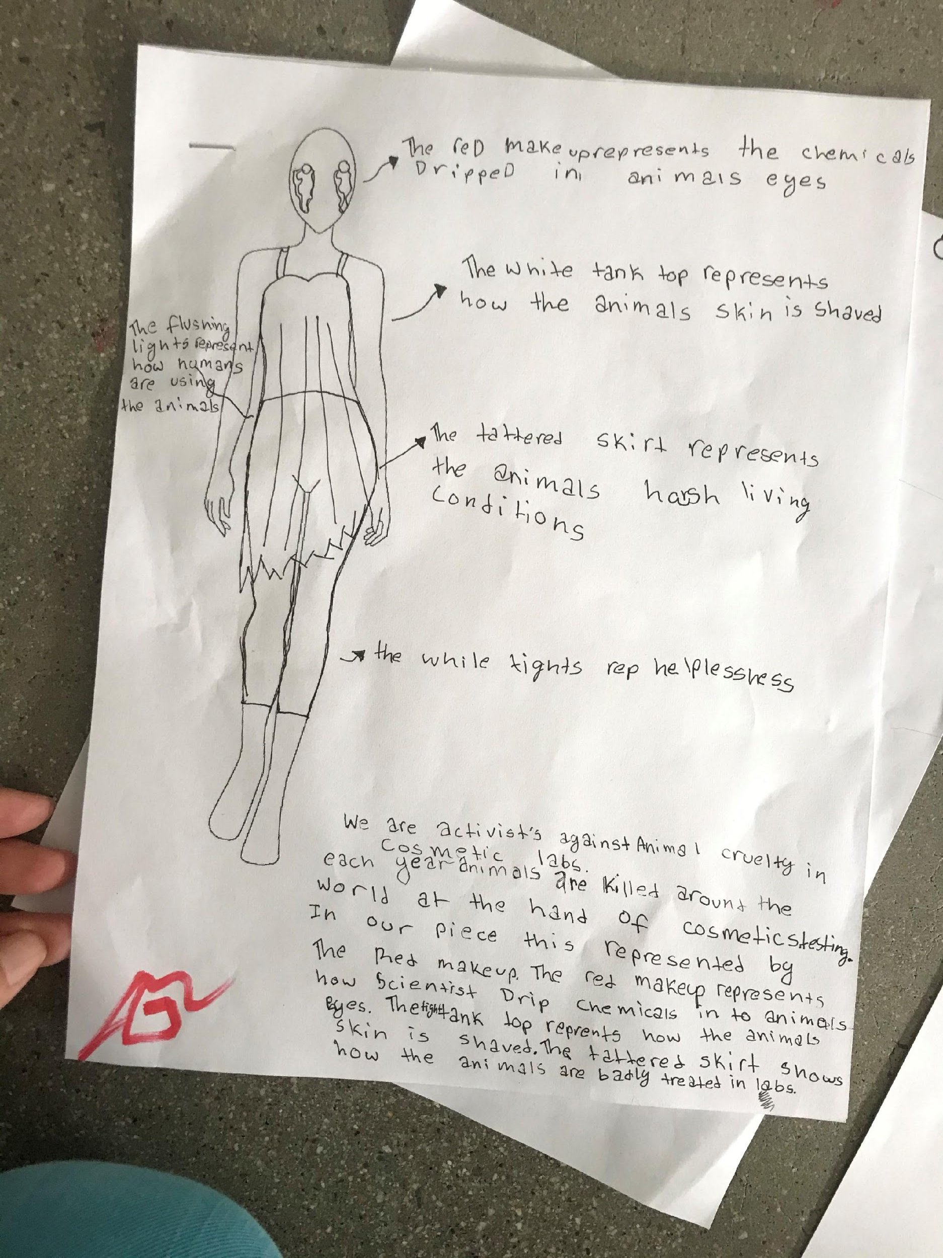
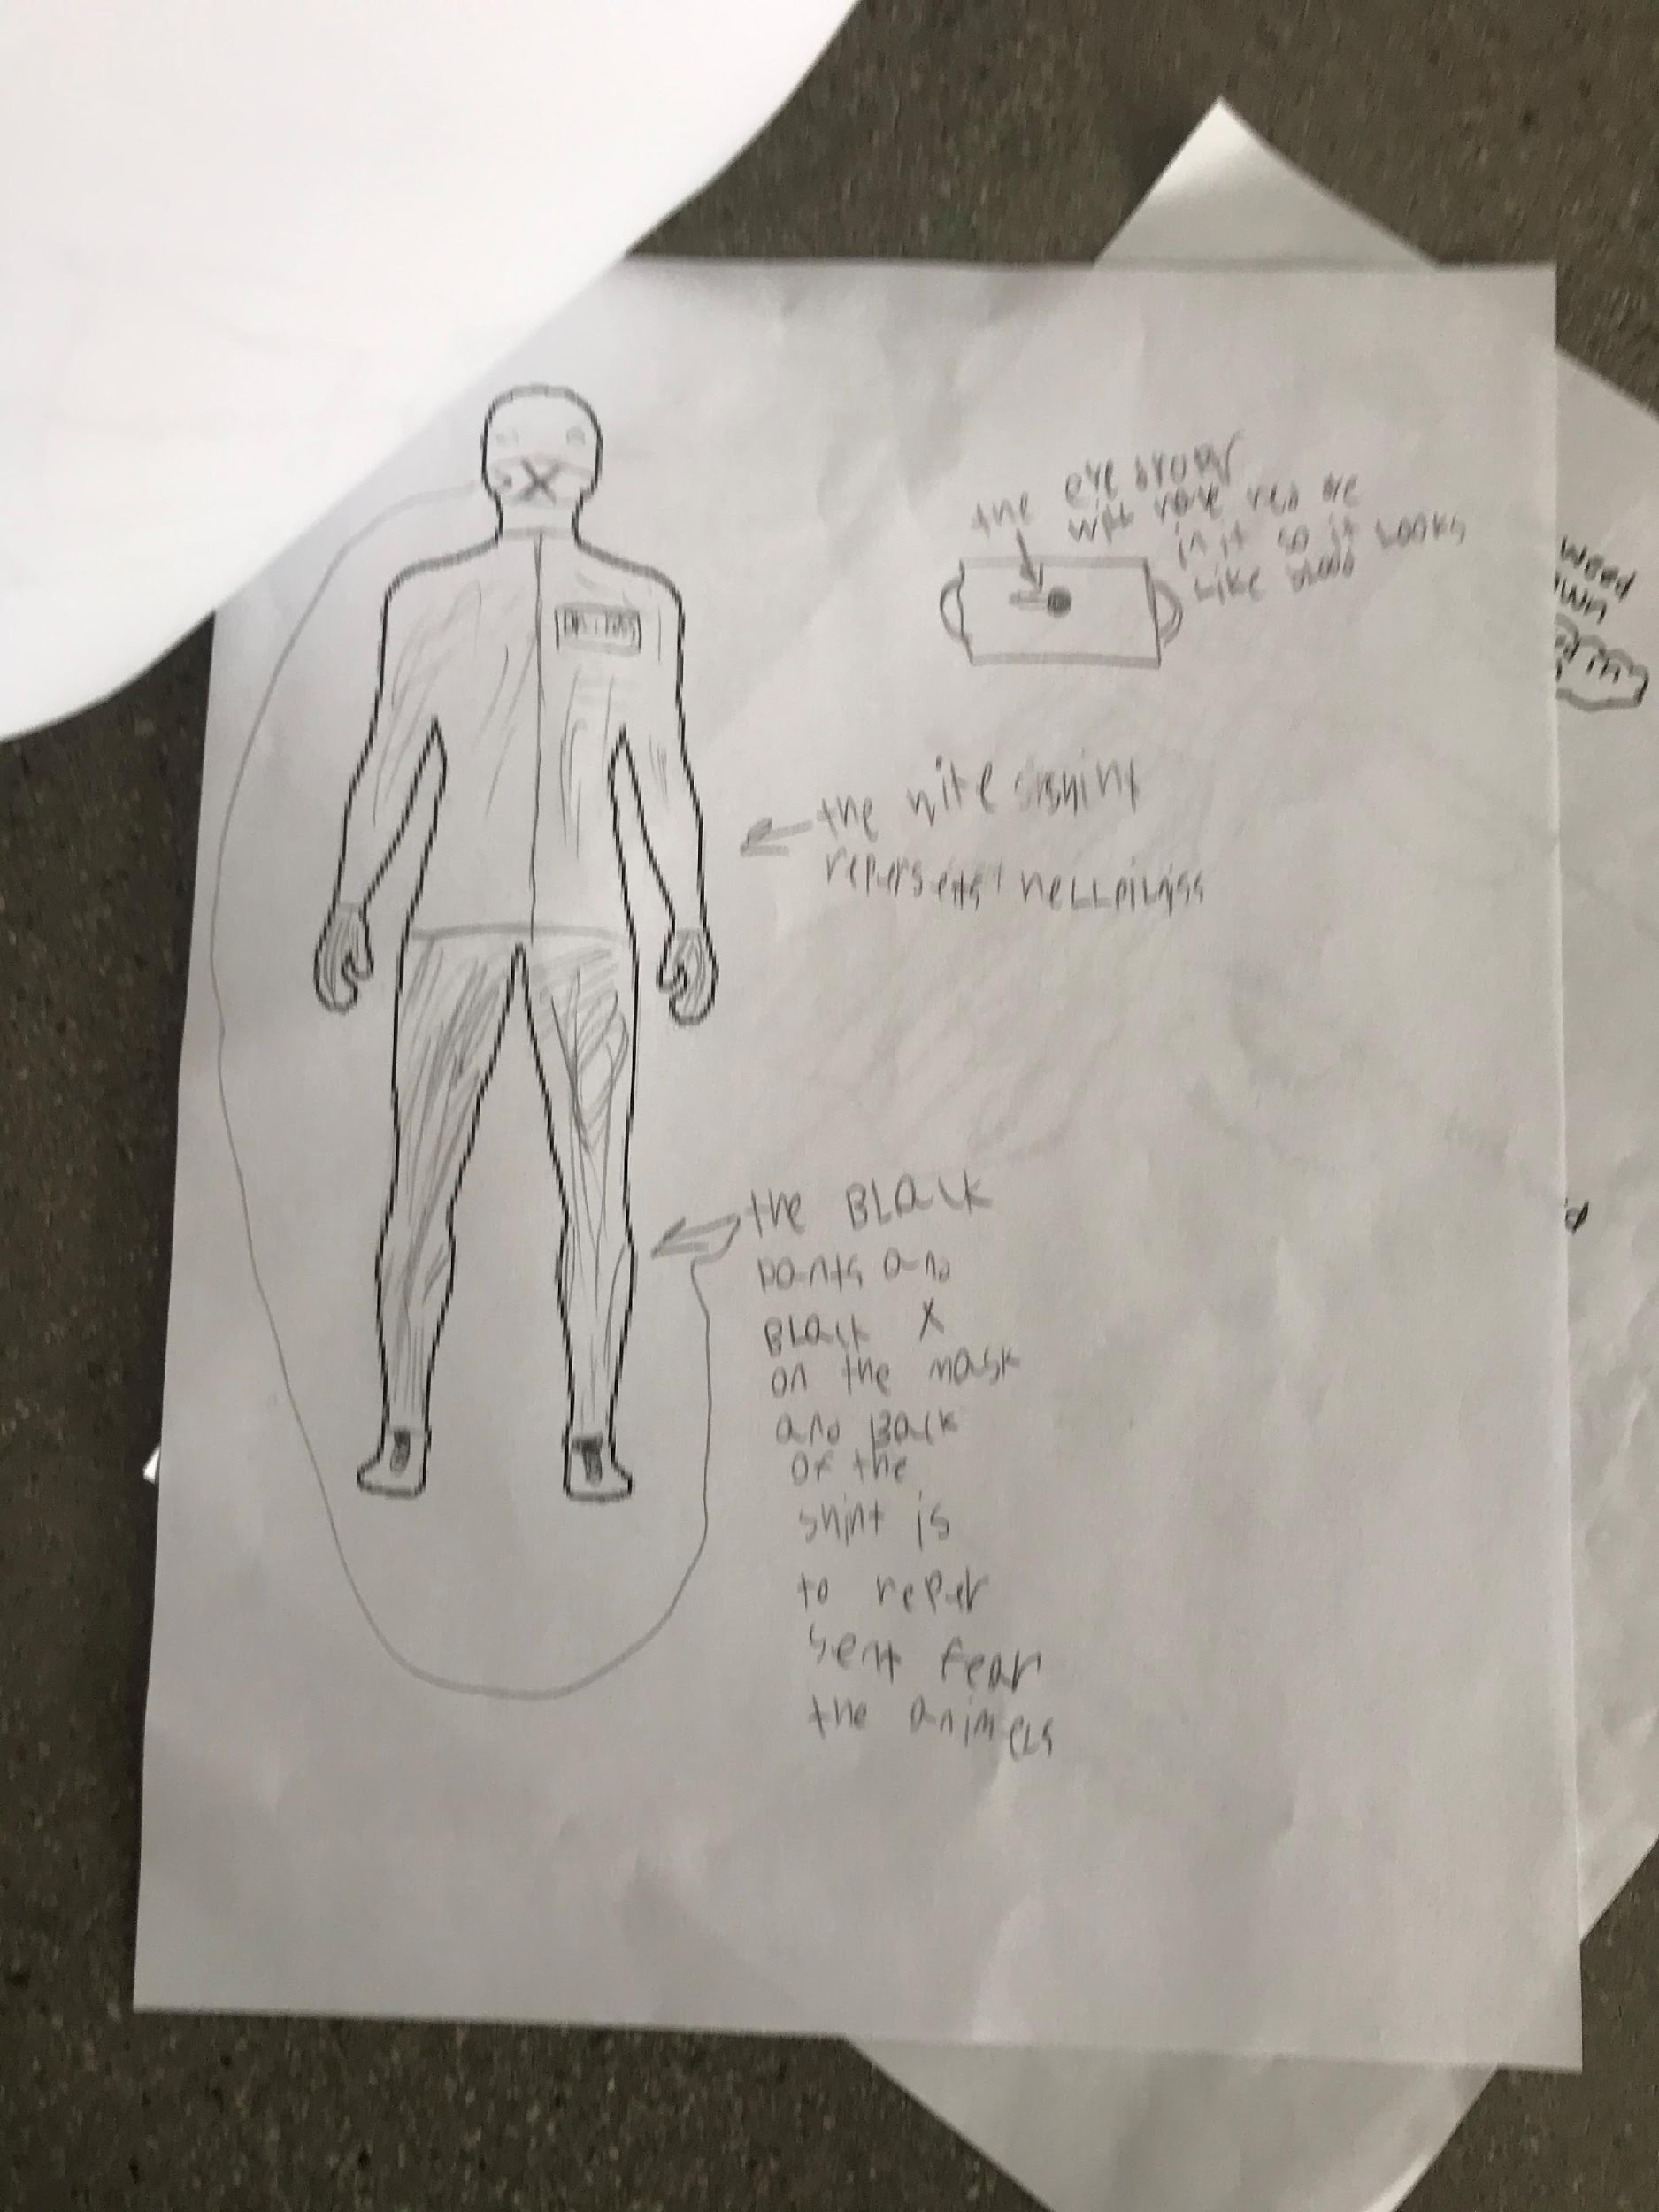
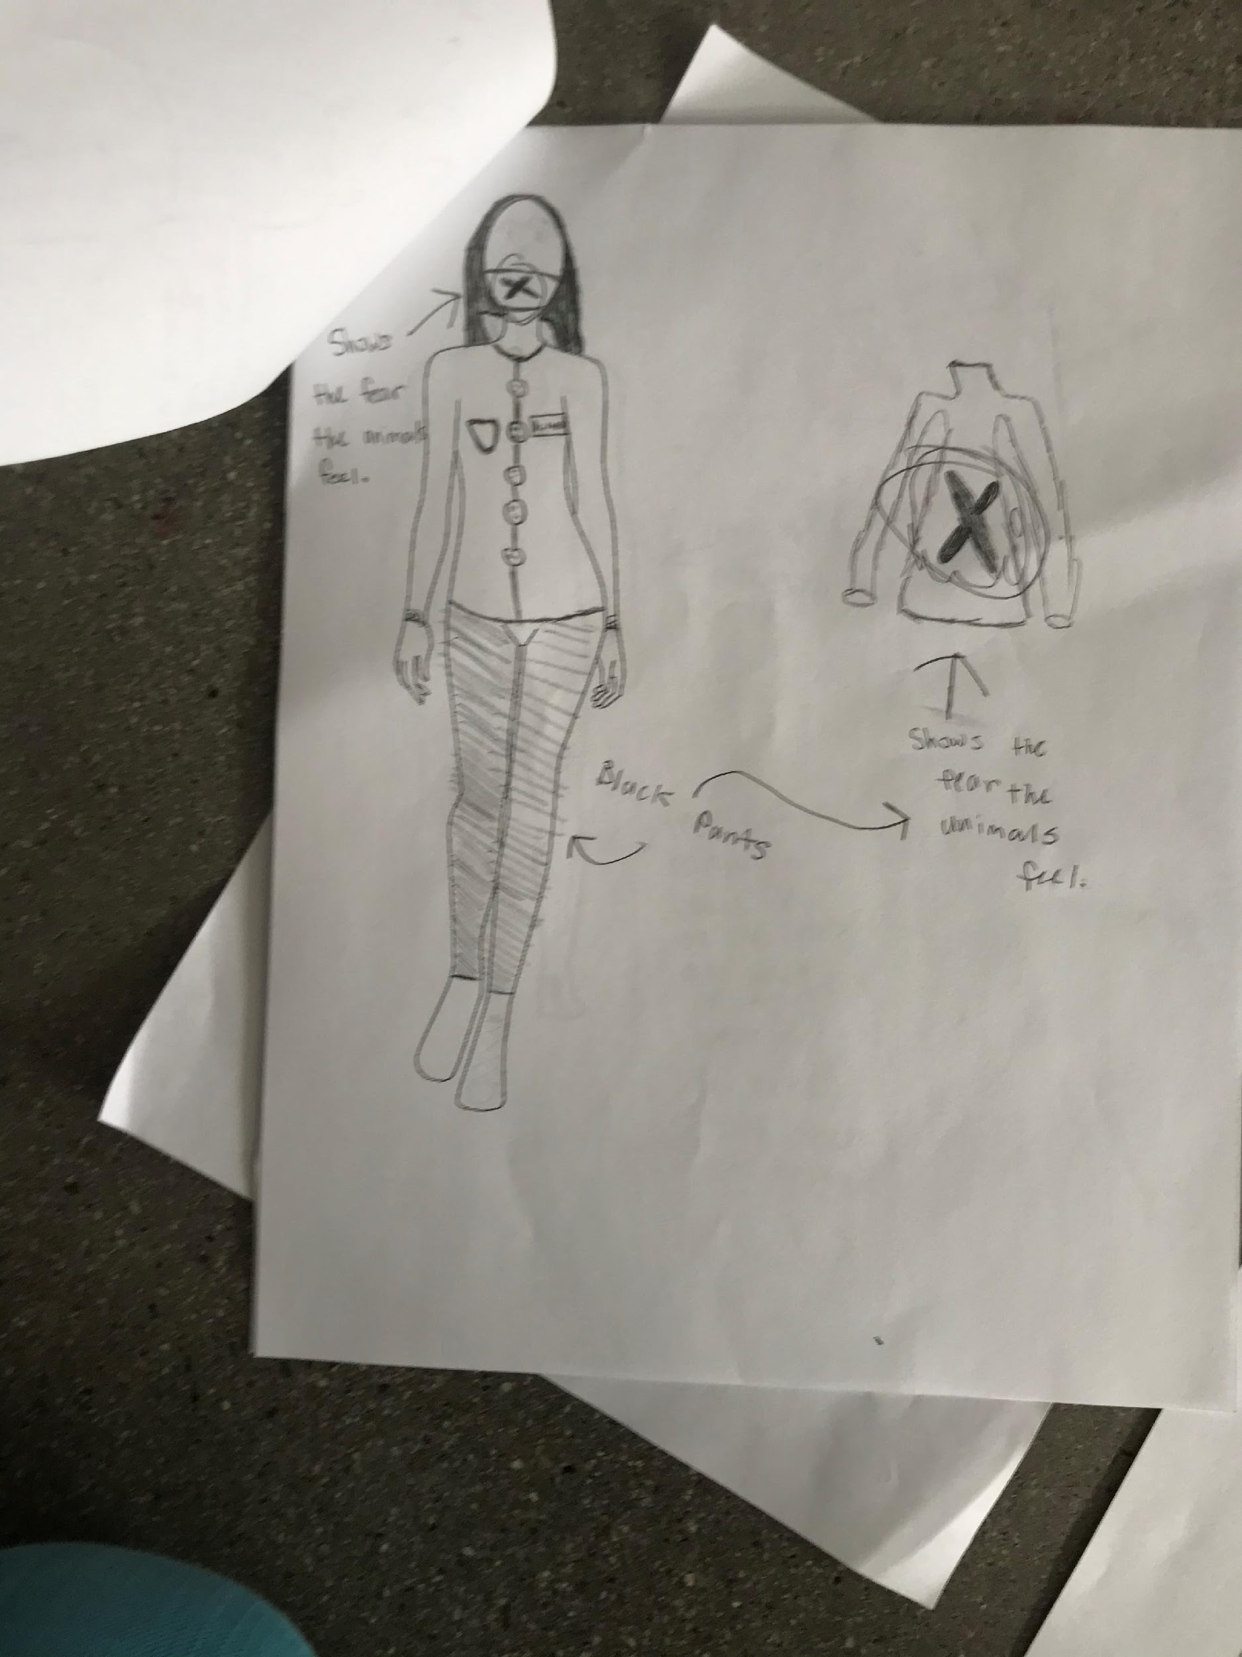
Against Animal Testing, 6th Grade
2nd Iteration – honing the story and impact

Slide 10
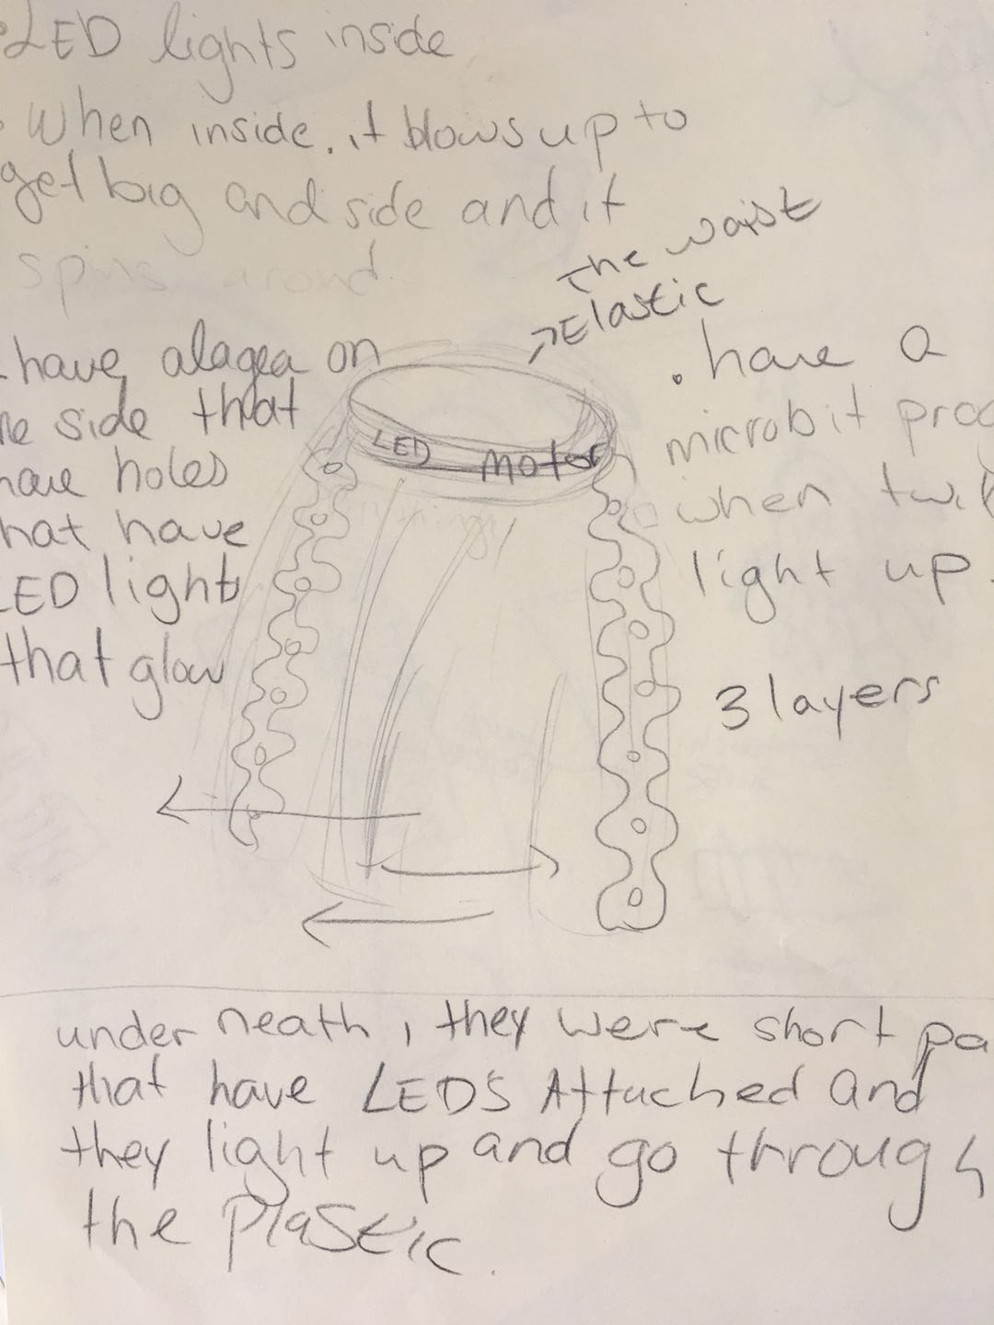
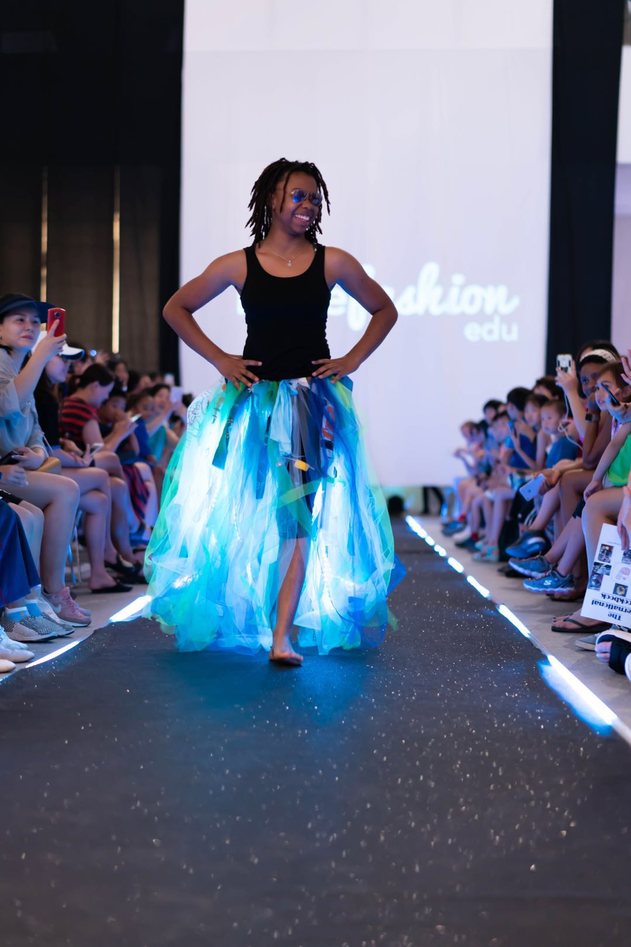
Ocean, 7th Grade
1st Iteration – use of tech to create the aura of the ocean
(designer had high technical aptitude prior to project)

